Slide 1
CLASSICAL WATERFALL MODEL

Slide 2
Classical Waterfall Model
Earliest and First approach of SDLC.
Known as Sequential Model and Linear – Sequential Model.
It very simple to understand and use.
Each phase must be completed before starting new phase.

Slide 3
Classical Waterfall Model
Classical waterfall model divides life cycle into phases:
  feasibility study,
  requirements analysis
  design,
  coding and unit testing,
  integration and system testing,
  maintenance.

Slide 4
Classical Waterfall Model
Feasibility Study
Req. Analysis
Design
Coding
Testing
Maintenance

Slide 5
Classical Waterfall Model (CONT.)
Most organizations usually define:
  entry and exit criteria for every phase.
They also prescribe specific methodologies for:
  specification,
  design,
  testing,
  project management, etc.

Slide 6
When should you use it?
Requirement are clear & fixed.
There is no ambiguous requirement.
It is good to use when model technology is well understood.

Slide 7
Why to study Waterfall Model?
Every other model is based on Waterfall Model.
To develop an understanding toward various phases of software development.

Slide 8
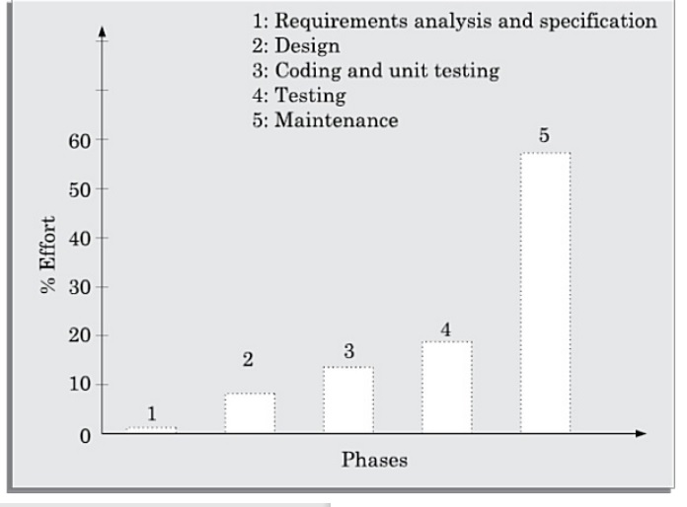
Classical Waterfall Model (CONT.)
Phases between feasibility and testing known as development phases.
Among all life cycle phases maintenance phase consume maximum effort.

Slide 9
Feasibility Study
Main aim of feasibility study: determine whether developing the product
  Legally Feasible
  Economically feasible
  technically feasible.
First roughly understand what the customer wants:
  different data which would be input to the system,
  processing needed on these data,
  output data to be produced by the system,
  various constraints on the behaviour of the system.

Slide 10
Activities during Feasibility Study
Work out an overall understanding of the problem.
Formulate different solution strategies.
Examine alternate solution strategies in terms of:
    resources required,
    cost of development, and
    development time.

Slide 11
Activities during Feasibility Study
Perform a cost/benefit analysis:
  to determine which solution is the best.
  you may determine that none of the solutions is feasible due to:
    high cost,
    resource constraints,
    technical reasons.

Slide 12
1. Ques- Waterfall model is also known as
Exploratory Model
Sequential Development Model
Life Cycle Model
Software Development Model

Slide 13
Requirements Analysis and Specification
Aim of this phase:
  understand the exact requirements of the customer,
  document them properly.
Consists of two distinct activities:
  requirements gathering and analysis
  requirements specification.

Slide 14
Goals of Requirements Analysis
Collect all related data from the customer:
  analyze the collected data to clearly understand what the customer wants,
  find out any inconsistencies and incompleteness in the requirements,
  resolve all inconsistencies and incompleteness.

Slide 15
Requirements Gathering
Gathering relevant data:
  usually collected from the end-users through interviews and discussions.
  For example, for a business accounting software:
    interview all the accountants of the organization to find out their requirements.

Slide 16
Requirements Analysis (CONT.)
The data you initially collect from the users:
  would usually contain several contradictions and ambiguities:
  each user typically has only a partial and incomplete view of the system.

Slide 17
Requirements Analysis (CONT.)
Ambiguities and contradictions:
  must be identified
  resolved by discussions with the customers.
Next, requirements are organized:
  into a Software Requirements Specification (SRS) document.

Slide 18
Requirements Analysis (CONT.)
Engineers doing requirements analysis and specification:
  are designated as analysts.

Slide 19
2. Which one is correct.?
In waterfall model exit and enter criteria is not fixed.
In waterfall model, there is freedom to choose any phase.
From Feasibility to Testing part also known as Linear Development Model
In waterfall model maintenance part consume most effort.

Slide 20
Design
Design phase transforms requirements specification:
  into a form suitable for implementation in some programming language.

Slide 21
Design
In technical terms:
  during design phase, software architecture is derived from the SRS document.
Two design approaches:
  traditional approach,
  object oriented approach.

Slide 22
Traditional Design Approach
Consists of two activities:
  Structured analysis
  Structured design

Slide 23
Structured Analysis Activity
Identify all the functions to be performed.
Identify data flow among the functions.
Decompose each function recursively into sub-functions.
  Identify data flow among the subfunctions as well.

Slide 24
Structured Analysis (CONT.)
Carried out using Data flow diagrams (DFDs).
After structured analysis, carry out structured design:
  architectural design (or high-level design)
  detailed design (or low-level design).

Slide 25
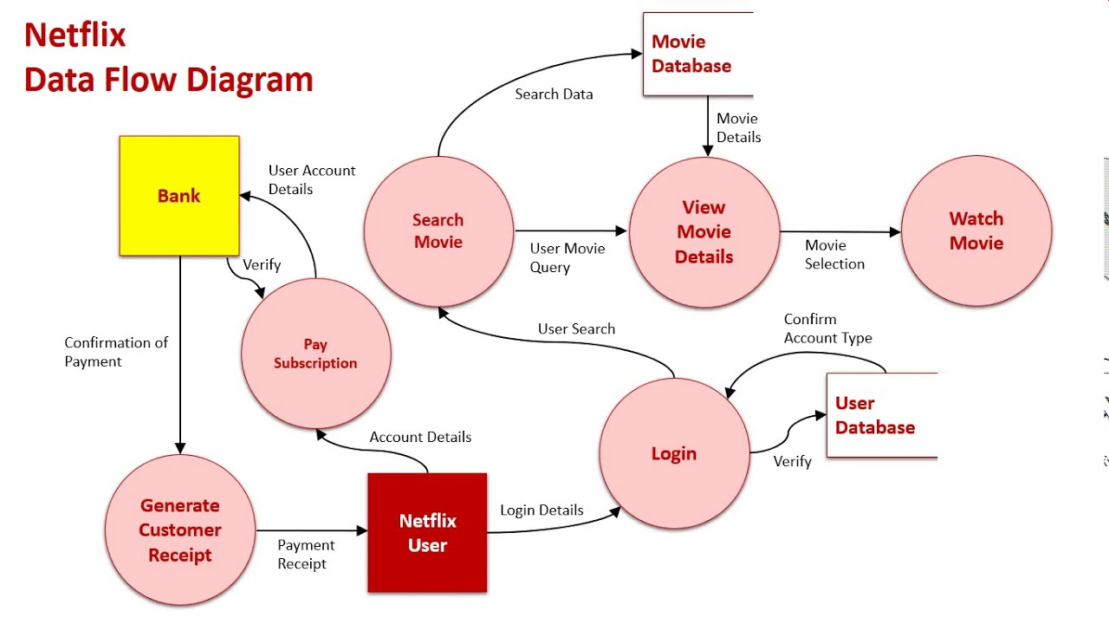
Structure Analysis (cont.)

Slide 26
Structured Design
High-level design:
  decompose the system into modules,
  represent relationships among the modules.
Detailed design:
  different modules designed in greater detail:
    data structures and algorithms for each module are designed.

Slide 27
Object Oriented Design
First identify various objects (real world entities) occurring in the problem:
  identify the relationships among the objects.
  For example, the objects in a pay-roll software may be:
    employees,
    managers,
    pay-roll register,
    Departments, etc.

Slide 28
Object Oriented Design (CONT.)
OOD has several advantages:
  lower development effort,
  lower development time,
  better maintainability.

Slide 29
Implementation
Purpose of implementation phase (coding and Unit Testing phase):
  translate software design into source code.

Slide 30
Implementation
During the implementation phase:
  each module of the design is coded,
  each module is unit tested
    tested independently as a stand alone unit, and debugged.

Slide 31
Implementation (CONT.)
The purpose of unit testing:
  test if individual modules work correctly.
The end product of implementation phase:
  a set of program modules that have been tested individually.

Slide 32
Integration and System Testing
Different modules are integrated in a planned manner:
  modules are almost never integrated in one shot.
  Normally integration is carried out through a number of steps.

Slide 33
Integration and System Testing
M1
M2
M3
M4

Slide 34
System Testing
After all the modules have been successfully integrated and tested:
  system testing is carried out.
Goal of system testing:
  ensure that the developed system functions according to its requirements as specified in the SRS document.

Slide 35
3. A step in waterfall model that involves a meeting with the customer to understand the requirements.
Requirement Gathering
SRS
Implementation
Customer review

Slide 36
4. In Waterfall Model, Each phase must be completed before the ______ .
Previous Phase
Next Phase
Both (a) & (b)
None

Slide 37
Maintenance
Maintenance of any software product:
  requires much more effort than the effort to develop the product itself.
  Ratio of development effort and maintenance effort is typically 40:60.

Slide 38
Maintenance (CONT.)
Corrective maintenance:
  Correct errors which were not discovered during the product development phases.
Perfective maintenance:
  Improve implementation of the system
  enhance functionalities of the system.
Adaptive maintenance:
  Port software to a new environment,
    e.g. to a new computer or to a new operating system.

Slide 39
Drawbacks of classical water fall model
No feedback paths
Difficult to accommodate changes
Limited customer interactions

Slide 40
5. ___________ is a step in which design is translated into machine-readable form.
Design
Conversion
Debugging
Coding

Slide 41
6. What do you call a technical person who is capable of understanding the basic requirements?
Team Leader
Analyst
Engineer
Stakeholder

